Slide 1

SBOL Visual
Presenter: Jacob Beal (BBN Technologies)
SBOL Workshop @ IWBDA, July, 2019
Cambridge, UK

Slide 2
Diagram Elements
Sequence Feature Glyphs
Molecular Species Glyph
Module
Nucleic Acid
Backbone
GFP
pTet
gfp
tetR
Interactions
Labels
Reverse Complement
Sequence Feature Glyphs
Interaction Node
aTc

Slide 3
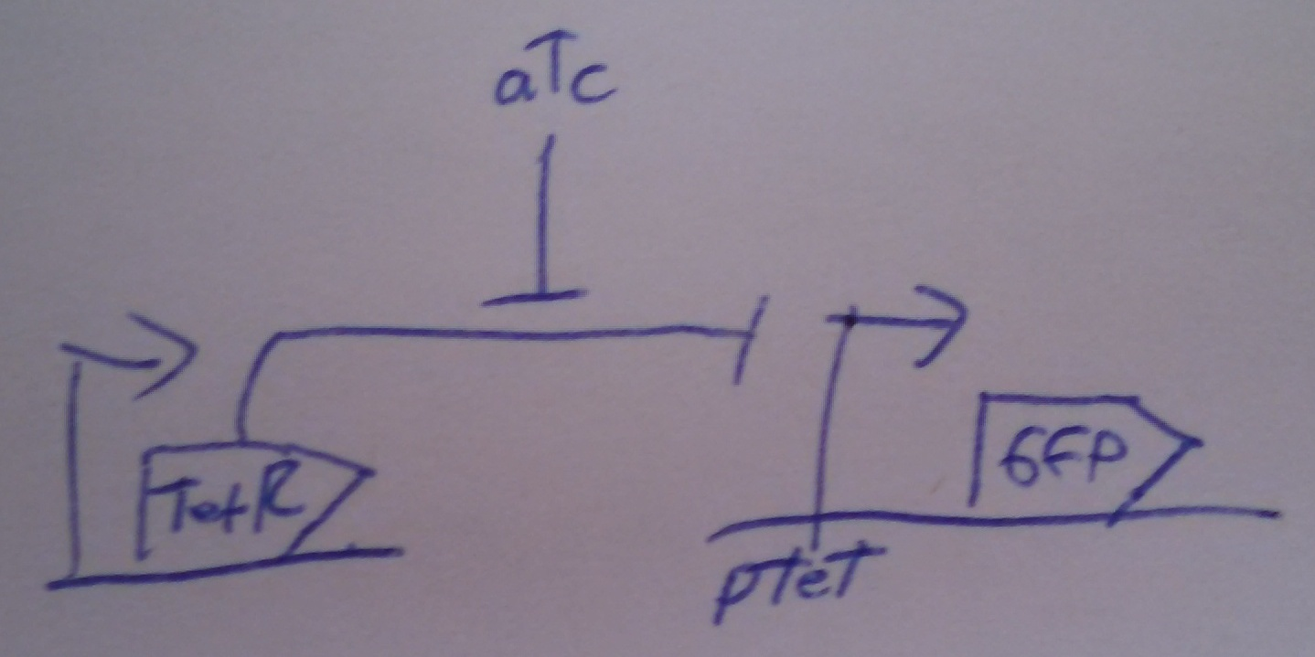
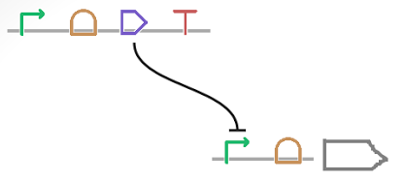
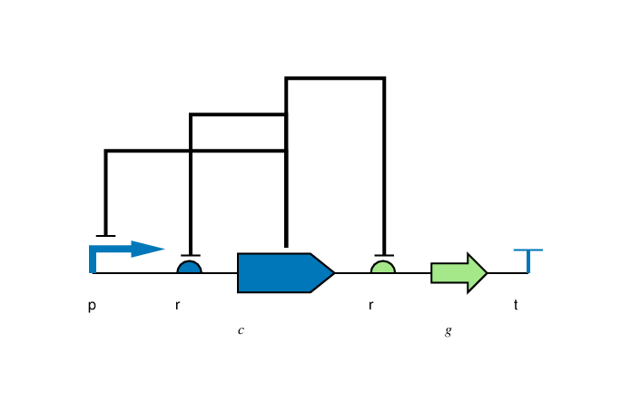
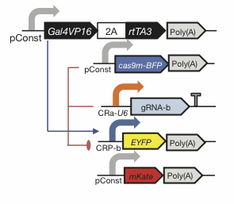
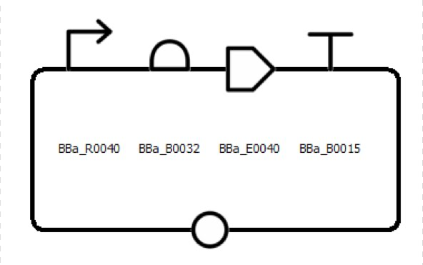
Flexibility of Style
Color, Text, Scaling, Strands, Styling: all your choice

Slide 4
Nucleic Acid Glyphs

Slide 5
Molecular Species & Interaction Glyphs
Molecular Species
superpose glyphs
alternate
recommended alternate
Complex
Macromolecule
No Glyph
Nucleic Acid (Generic)
alternates
recommended alternate
Nucleic Acid (1-Strand)
Nucleic Acid (2-Strand)
Simple Chemical
Unspecified
Interaction
Control
Degradation
Inhibition
Process
Stimulation
Association
Dissociation
Process

Slide 6
Making SBOL Visual Diagrams
Using your favorite graphics editor:
Many glyphs can be drawn directly
Glyph set available: http://sbolstandard.org/visual/
Specialized visualization tools:
VisBOL: http://visbol.org/design/
GraphViz: http://www.graphviz.org/
DNAPlotLib: https://github.com/VoigtLab/dnaplotlib

Slide 7
Example: CRISPR Device

Slide 8
Example: CRISPR Circuit

Slide 9
Example: Rule 30 Circuit

Slide 10
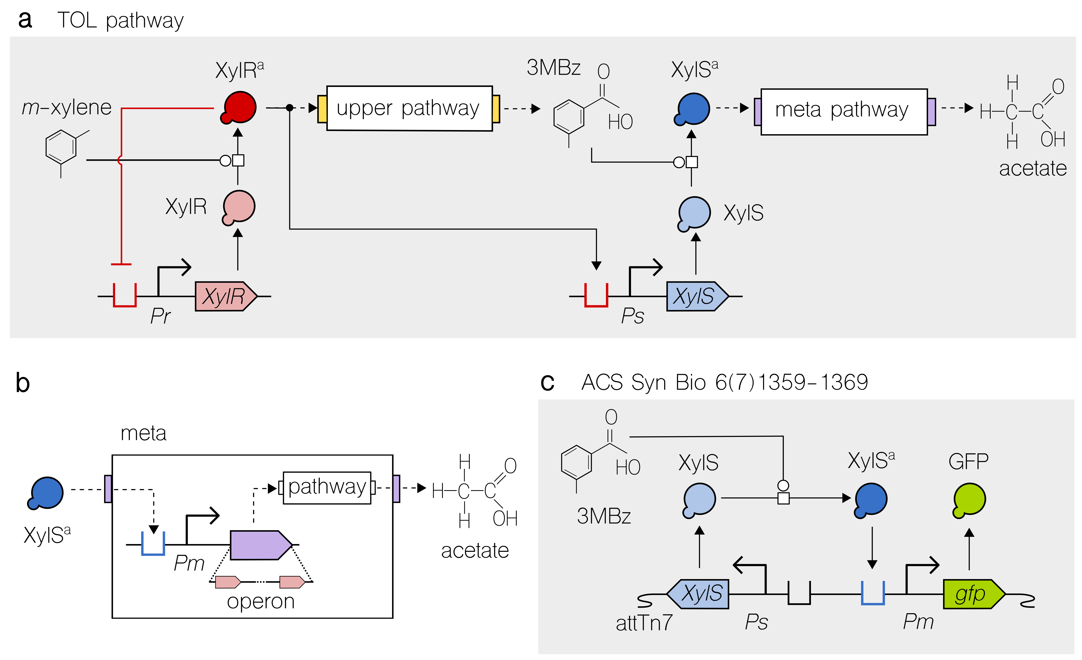
Example: Pathway Engineering

Slide 11
Example: Genome Engineering

Slide 12
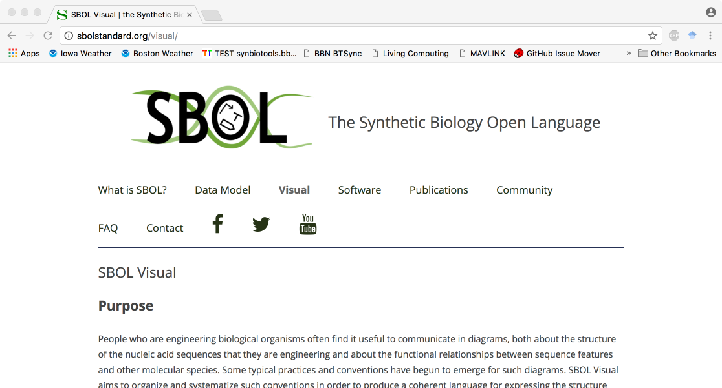
http://sbolstandard.org
Use the symbols in your papers & talks
Contribute opinions, use cases, new symbols
Community is open for anyone to join

Slide 13
How to Contribute to SBOL
Presenter: Jacob Beal (BBN Technologies)
SBOL Workshop @ IWBDA, July, 2019
Cambridge, UK

Slide 14
SBOL Community Structure
sbol-announce@googlegroups.com
people who want to know what’s going on with SBOL
sbol-dev@googlegroups.com
people interested in contributing to standards, tools; electorate
community
managers
Editors
Chair
strategic
leadership
SBOL Industrial
Steering Comm.
Advisory Panel
Industrial user group
PIs helping chair
External perspective

Slide 15
How can I get involved?
Use SBOL & SBOL Visual!
Report issues and get help when you need it
Join sbol-announce, sbol-dev mailing lists
Organizations: join SBOL Industrial
Develop or contribute to libraries & tools
Help improve the standards
Help govern the community

Slide 16
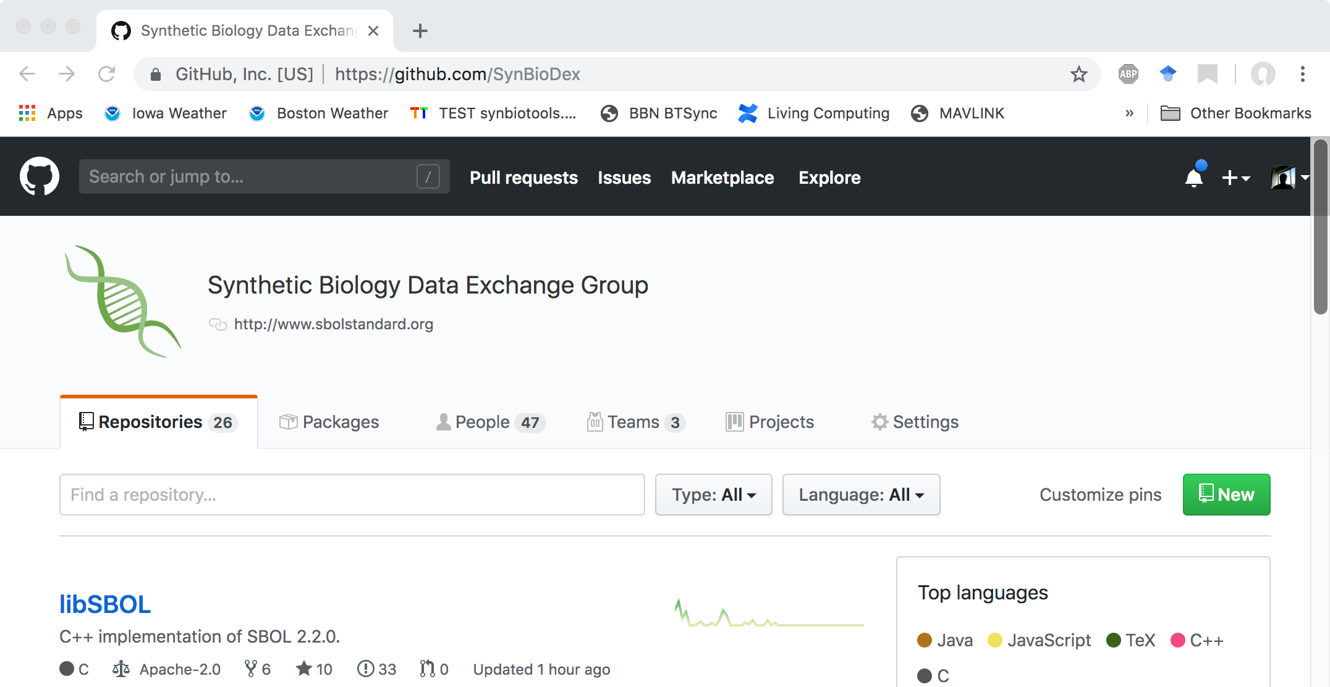
Community GitHub: SynBioDex
Development hub for specs, libraries, tutorials, etc.

Slide 17
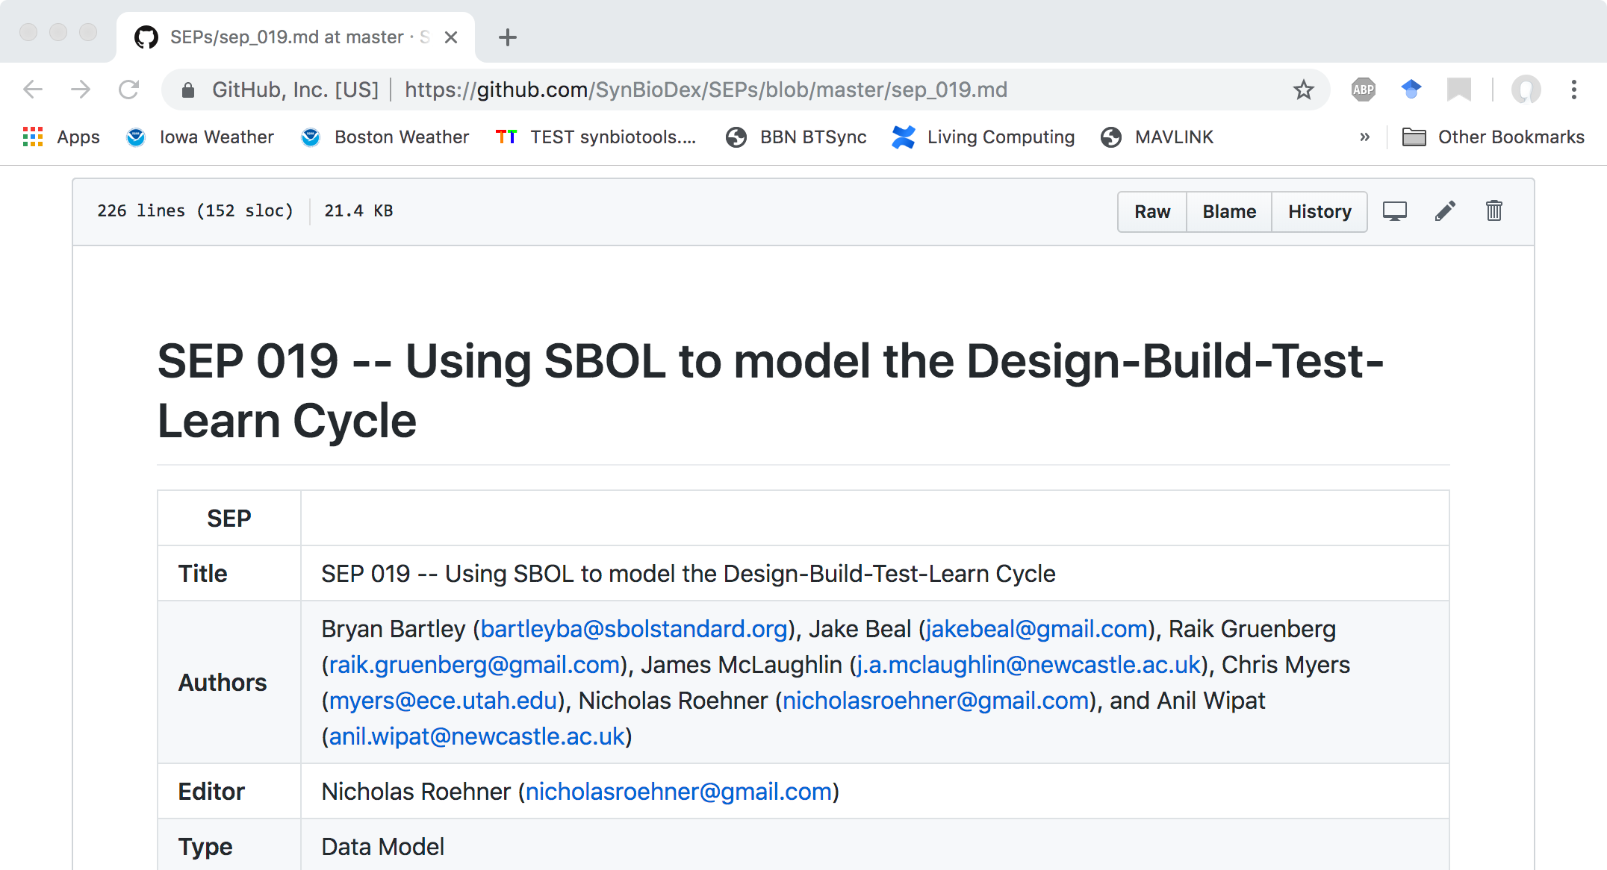
Improving the standards: SEPs
Spec changes via “SBOL Enhancement Proposals” (SEPs) voted on by sbol-dev community

Slide 18








SBOL Industrial Consortium
Pre-competitive organization:
Companies investing in SBOL
Coordination of priorities, sharing of best practices
Support community infrastructure & development

